Slide 1
Intuilize – Cluster Commanders Customer Segmentation & Prediction Weekly Meeting 4/11/2025
Andy, Graham, Keertana, & Shashank

Slide 2
Agenda
Updated table
Monthly predition approach
Feedback on table
Automating feature selection
Documentation progress

Slide 3
Feedback
Customer Tiers | Initial number of customers in the tier | Predicted number of customers in the tier
Platinum | 12 | 19 (↑ 7)
Diamond | 7 | 2 (↓ 5)
Gold | 2 | 2
Silver | 928 | 929 (↑ 1)
Bronze | 37 | 34 (↓ 3)
Rock | 0 | 0
Use +/- instead of arrows in predicted number of customers
Format for readability

Slide 4
Updated Table ( With new results)
TIER | Current Customer Count | Predicted Customer Count | Change | Insights
Platinum | 8 | 0 | -8 | Significant Drop
Diamond | 6 | 8 | +2 | Small Growth
Gold | 4 | 8 | +4 | Small Growth
Silver | 15 | 44 | +29 | Significant Growth
Bronze | 51 | 24 | -27 | Significant Drop
Rock | 955 | 955 | 0 | No Change

Slide 5
Time Sequence –Monthly Approach
1) Incorporating Feedback
2) Predicting next cluster by learning previous cluster movement behavior
3) Train 1 model to learn general transition and customer specific transitions

Slide 6
Documentation progress
Finishing previous progress document
01
Finishing data model design and plan document
02
Starting handover documentation
03

Slide 7
Next Steps
Finish Documentation
Continue work with new approach
Improve Markov Chain

Slide 8
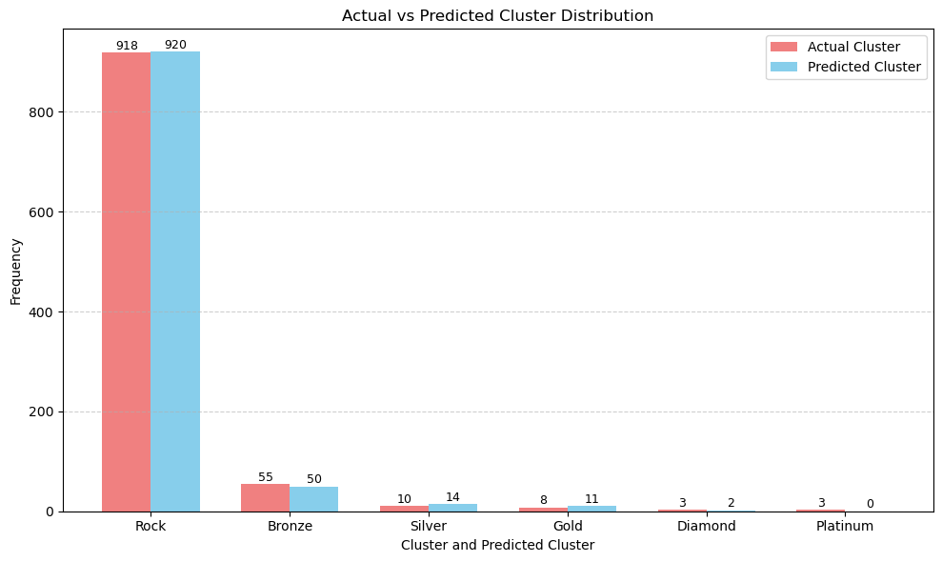
THANK YOU!

